Slide 1



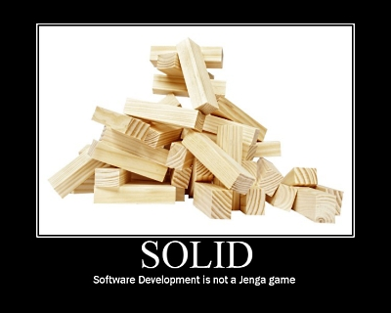
SOLID and Other Principles
SOLID, DRY, YAGNI, KISS
Telerik Software Academy
Learning & Development
http://academy.telerik.com

Slide 2

Table of Contents
SOLID Principles
SRP – Single Responsibility Principle
OCP – Open/Closed Principle
LSP – Liskov Substitution Principle
ISP – Interface Segregation Principle
DIP – Dependency Inversion Principle
DRY – Don't Repeat Yourself
YAGNI – You Aren't Gonna Need It
KISS – Keep It Simple, Stupid

Slide 3
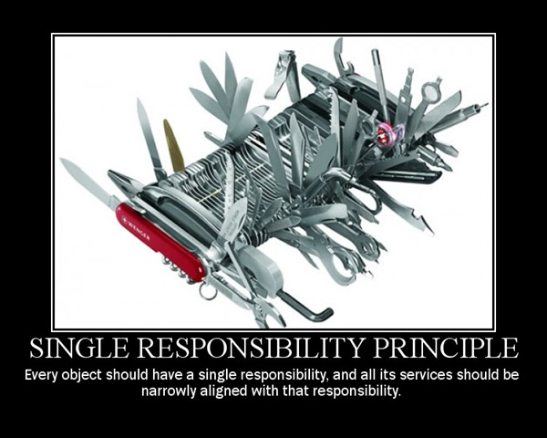
Single Responsibility

Slide 4
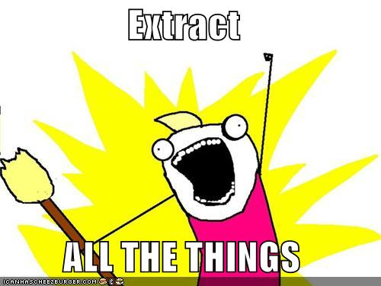
SRP
"The Single Responsibility Principle states that every object should have a single responsibility, and that responsibility should be entirely encapsulated by the class."
Wikipedia
"There should never be more than one reason for a class to change."
Robert C. “Uncle Bob” Martin

Slide 5
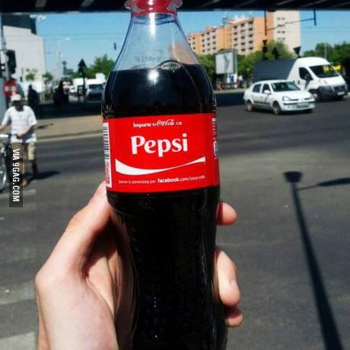
SRP
Cohesion
Relation of responsibilities
Focused on one task
Coupling
Dependency on other modules
Relationship between modules
Ideal - low coupling / strong cohesion

Slide 6

SRP
Responsibilities
"A reason to change"
Mapped to project requirements
More requirements – more possible changes
More responsibilities – more changes in code
Multiple responsibilities in one class – coupling
More coupling – more errors on change

Slide 7
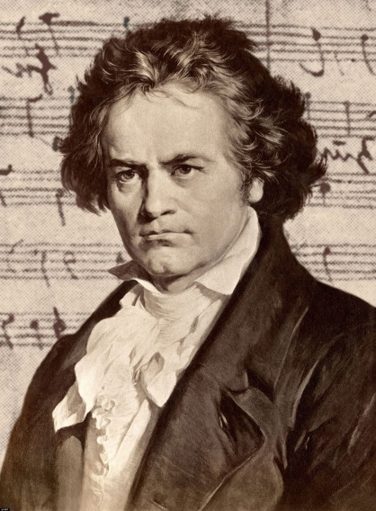
SRP
Classic violations
Objects that can print/draw themselves
Objects that can save/restore themselves
Classic solution
Separate printer
Separate saver (or memento)

Slide 8

SRP
Solution
Multiple small interfaces (ISP)
Many small classes
Distinct responsibilities
Result
Flexible design
Lower coupling
Higher cohesion

Slide 9
Single Responsibility
Live Demo

Slide 10
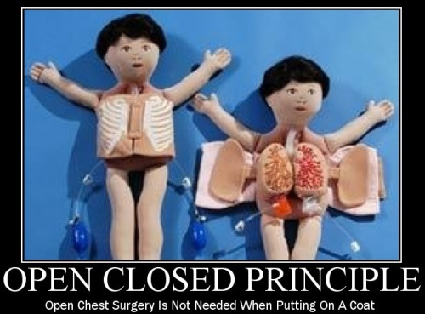
Open/Closed Principle

Slide 11
OCP
"The Open / Closed Principle states that software entities (classes, modules, functions, etc.) should be open for extension, but closed for modification."
Wikipedia
Open to Extension
New behavior can be added in the future
Closed to Modification
Changes to source or binary code are not required

Slide 12

OCP
Change behavior without changing code?!
Rely on abstractions, not implementations
Do not limit the variety of implementations
In .NET
Interfaces
Abstract Classes
In procedural code
Use parameters

Slide 13
OCP
Classic violations
Each change requires re-testing (possible bugs)
Cascading changes through modules
Logic depends on conditional statements
Classic solution
New classes (nothing depends on them yet)
New classes (no legacy coupling)

Slide 14
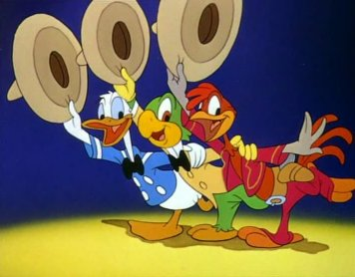
OCP
Three approaches to achieve OCP
Parameters
Pass delegates / callbacks
Inheritance / Template Method pattern
Child types override behavior of a base class
Composition / Strategy pattern
Client code depends on abstraction
"Plug in" model

Slide 15
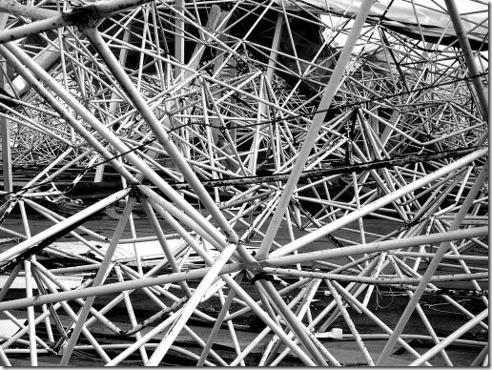
OCP
When to apply OCP?
Experience tell you
"Fool me once, shame on you"
Don't apply OCP at first
If module changes once, accept it
If it changes a second time, refactor for OCP
OCP add complexity to design (TANSTAAFL)
No design can be closed against all changes

Slide 16
Open / Closed
Live Demo

Slide 17
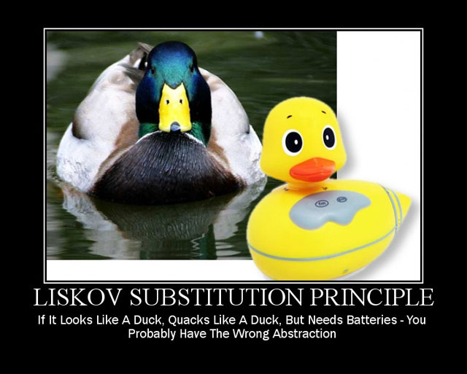
Liskov Substitution

Slide 18
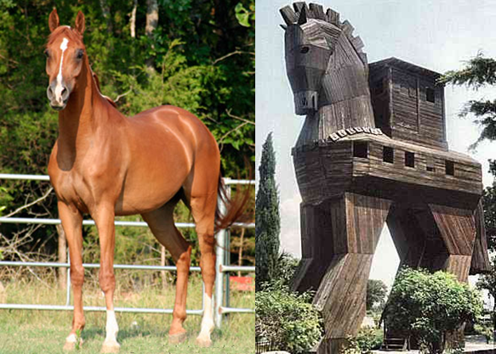
LSP
"The Liskov Substitution Principle states that Subtypes must be substitutable for their base types."
Agile Principles, Patterns, and Practices in C#
Substitutability – child classes must not
Remove base class behavior
Violate base class invariants

Slide 19
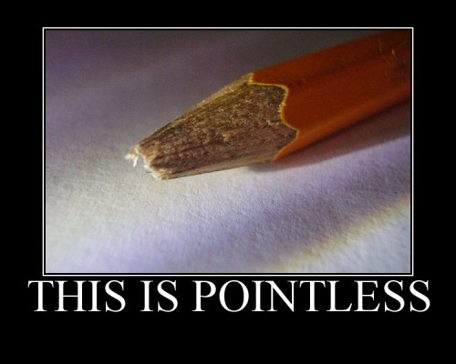
LSP
Normal OOP inheritance
IS-A relationship
Liskov Substitution inheritance
IS-SUBSTITUTABLE-FOR

Slide 20
LSP
The problem
Polymorphism break
Client code expectations
"Fixing" by adding if-then – nightmare (OCP)
Classic violations
Type checking for different methods
Not implemented overridden methods
Virtual methods in constructor

Slide 21


LSP
Solutions
"Tell, Don't Ask"
Don’t ask for types
Tell the object what to do
Refactoring to base class
Common functionality
Introduce third class

Slide 22
Liskov Substitution
Live Demo

Slide 23
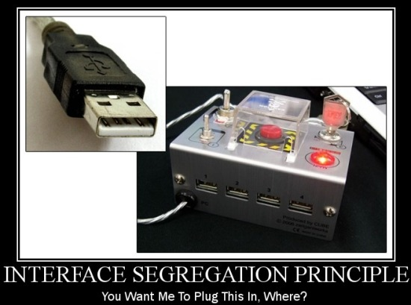
Interface Segregation

Slide 24

ISP
"The Interface Segregation Principle states that Clients should not be forced to depend on methods they do not use."
Agile Principles, Patterns, and Practices in C#
Prefer small, cohesive interfaces
Divide "fat" interfaces into smaller ones

Slide 25
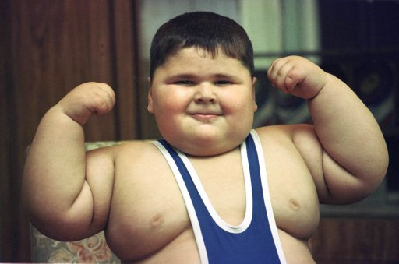
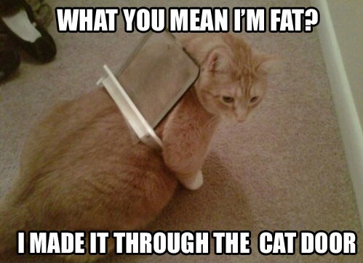
ISP
Interface is:
The interface type
All public members of a class
Having "fat" interfaces leads to:
Classes having methods they do not need
Increasing coupling
Reduced flexibility
Reduced maintainability

Slide 26
ISP
Classic violations
Unimplemented methods (also in LSP)
Use of only small portion of a class
When to fix?
Once there is pain! Do not fix, if is not broken!
If the "fat" interface is yours, separate it to smaller ones
If the "fat" interface is not yours, use "Adapter" pattern

Slide 27

ISP
Solutions
Small interfaces
Cohesive interfaces
Focused interfaces
Let the client define interfaces
Package interfaces with their implementation

Slide 28
Interface Segregation
Live Demo

Slide 29
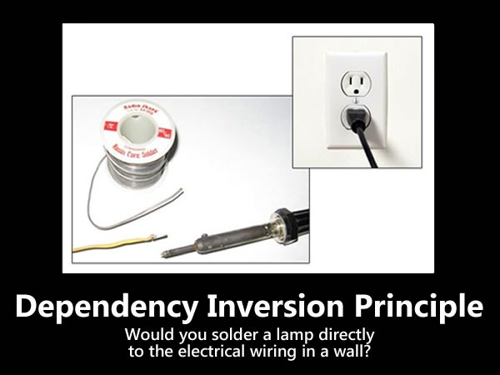
Dependency Inversion

Slide 30
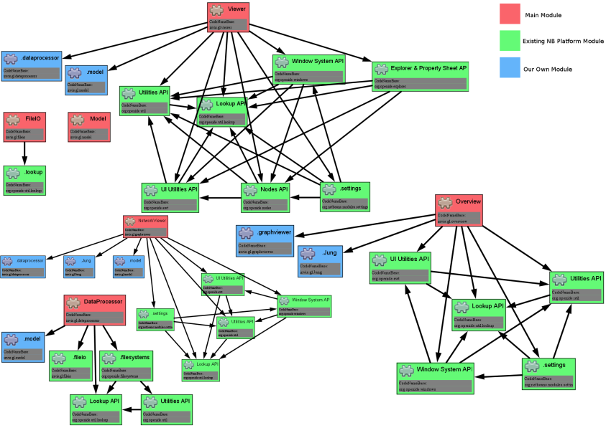
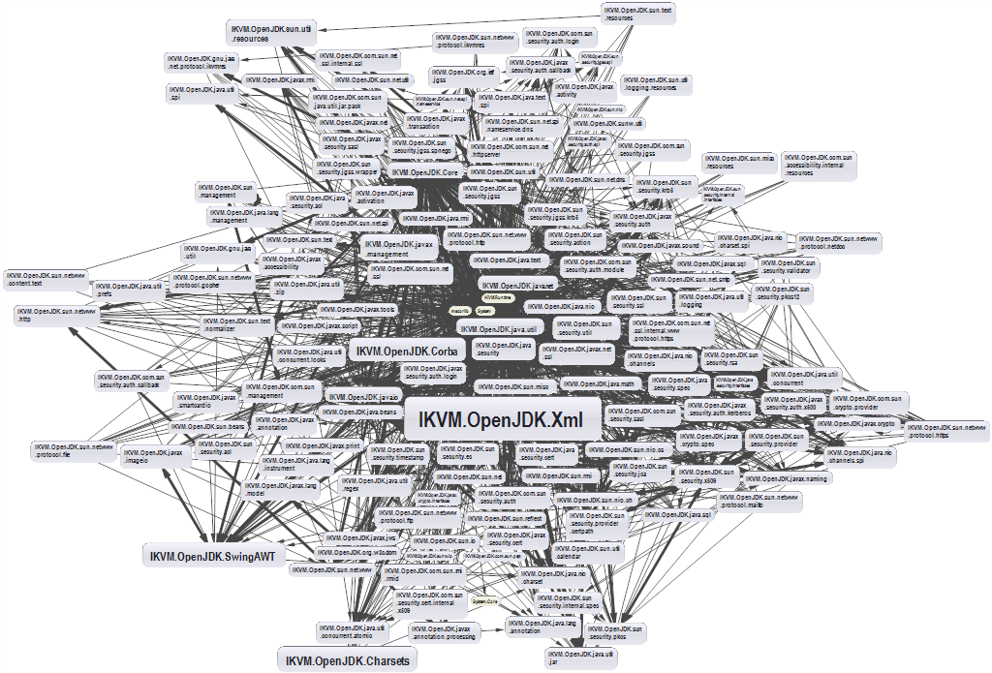
DIP
"High-level modules should not depend on low-level modules. Both should depend on abstractions."
"Abstractions should not depend on details. Details should depend on abstractions."
Agile Principles, Patterns, and Practices in C#

Slide 31
DIP
Dependency is:
Framework
Third Party Libraries
Database
File System
Email
Web Services
System Resources (Clock)
Configuration
The new Keyword
Static methods
Thread.Sleep
Random

Slide 32
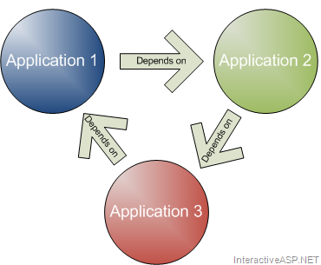
DIP
Traditional Programming
High level modules use lower lever modules
UI depends on Business Layer
Business layer depends on
Infrastructure
Database
Utilities
Static methods (Façade for example)
Classes instantiated everywhere

Slide 33

DIP
How it should be
Classes should declare what they need
Constructors should require dependencies
Hidden dependencies should be shown
Dependencies should be abstractions
How to do it
Dependency Injection
The Hollywood principle "Don't call us, we'll call you!"

Slide 34

DIP
Constructor injection
Dependencies – through constructors
Pros
Classes self document requirements
Works well without container
Always valid state
Cons
Many parameters
Some methods may not need everything

Slide 35

DIP
Property injection
Dependencies – through setters
Pros
Can be changed anytime
Very flexible
Cons
Possible invalid state
Less intuitive

Slide 36

DIP
Parameter injection
Dependencies – through method parameter
Pros
No change in rest of the class
Very flexible
Cons
Many parameters
Breaks method signature

Slide 37

DIP
Classic violations
Using of the new keyword
Using static methods/properties
How to fix?
Default constructor
Main method/starting point
Inversion of Control container

Slide 38
DIP
IoC containers
Responsible for object instantiation
Initiated at application start-up
Interfaces are registered into the container
Dependencies on interfaces are resolved
Examples – StructureMap, Ninject and more

Slide 39
Dependency Inversion
Live Demo

Slide 40
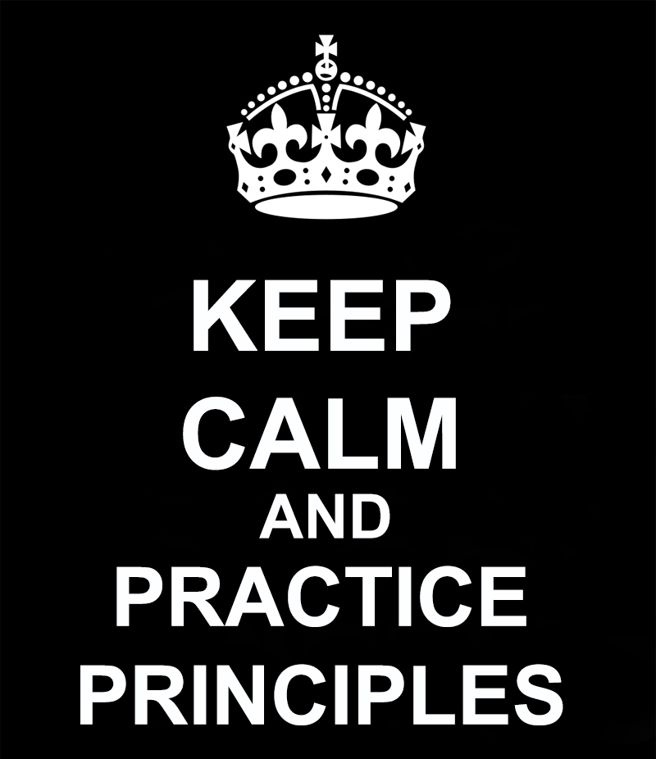
Other Principles

Slide 41
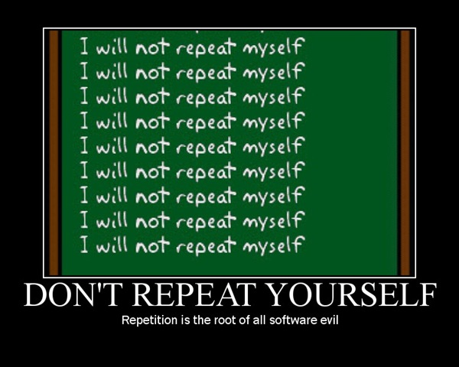
Don't Repeat Yourself

Slide 42

DRY
"Every piece of knowledge must have a single, unambiguous representation in the system."
The Pragmatic Programmer
"Repetition in logic calls for abstraction. Repetition in process calls for automation."
97 Things Every Programmer Should Know
Variations include:
Once and Only Once
Duplication Is Evil (DIE)

Slide 43
DRY
Classic violations
Magic Strings/Values
Duplicate logic in multiple locations
Repeated if-then logic
Conditionals instead of polymorphism
Repeated Execution Patterns
Lots of duplicate, probably copy-pasted, code
Only manual tests
Static methods everywhere

Slide 44
Don't Repeat Yourself
Live Demo

Slide 45

You Ain't Gonna Need It

Slide 46
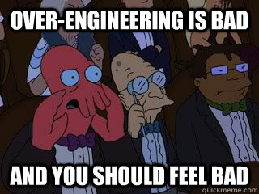
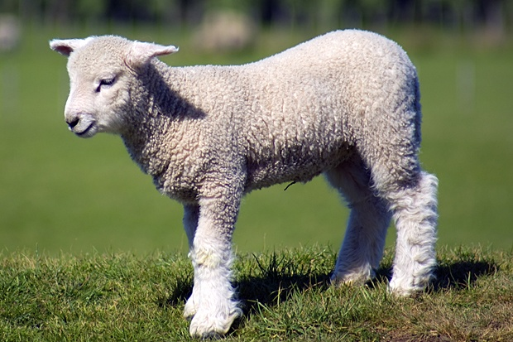
YAGNI
"A programmer should not add functionality until deemed necessary."
Wikipedia
"Always implement things when you actually need them, never when you just foresee that you need them."
Ron Jeffries, XP co-founder

Slide 47
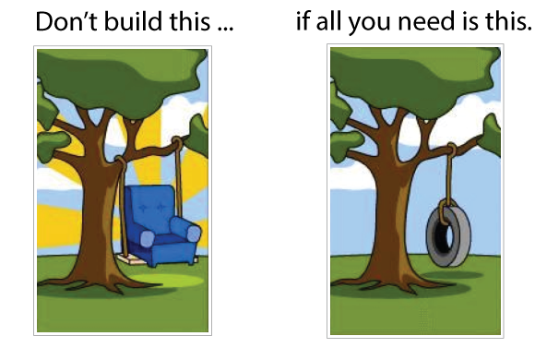
YAGNI
Disadvantages
Time for adding, testing, improving
Debugging, documented, supported
Difficult for requirements
Larger and complicate software
May lead to adding even more features
May be not know to clients

Slide 48
You Ain't Gonna Need It
Live Demo

Slide 49
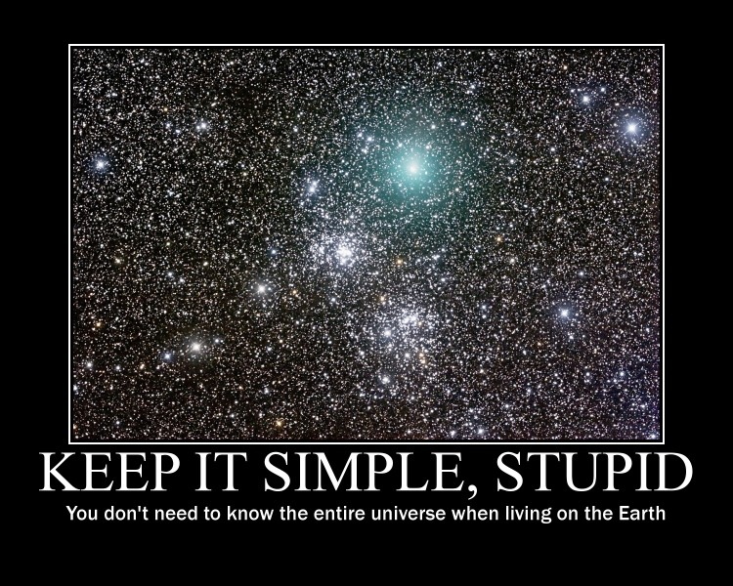
Keep It Simple, Stupid

Slide 50
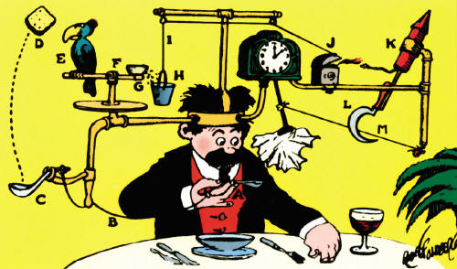

KISS
"Most systems work best if they are kept simple."
U.S. Navy
"Simplicity should be a key goal in design and unnecessary complexity should be avoided."
Wikipedia

Slide 51
Keep It Simple Stupid
Live Demo

Slide 52

Even More Principles

Slide 53

Golden Hammer

Slide 54
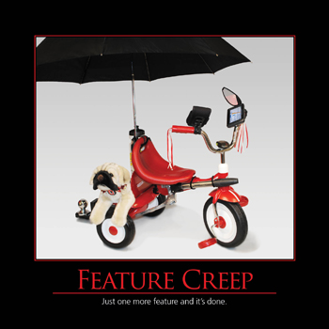
Feature Creep

Slide 55

Death March

Slide 56
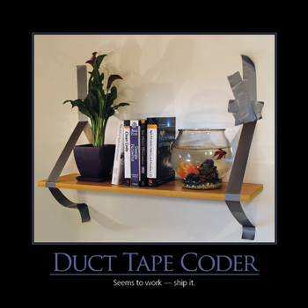
Duck Tape Coder

Slide 57
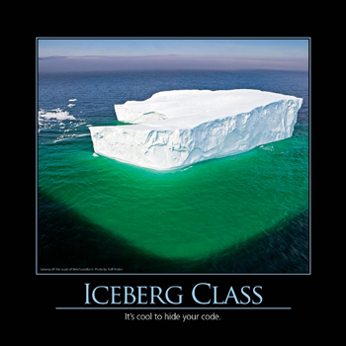
Iceberg Class

Slide 58
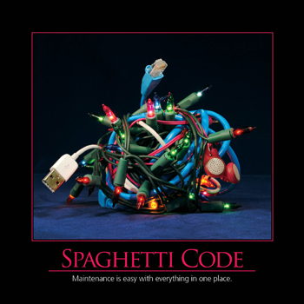
Spaghetti Code

Slide 59
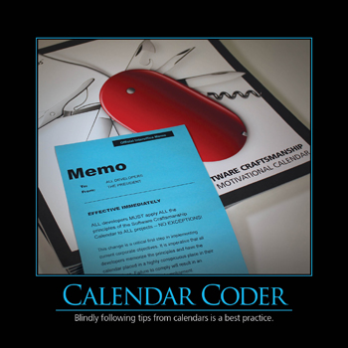
Calendar Coder

Slide 60
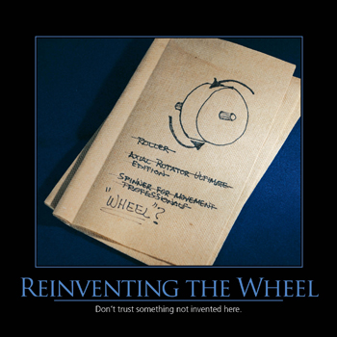
Reinventing The Wheel

Slide 61
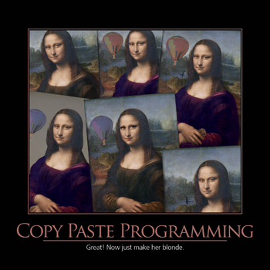
Copy Paste Programming

Slide 62

Boy Scout Rule

Slide 63
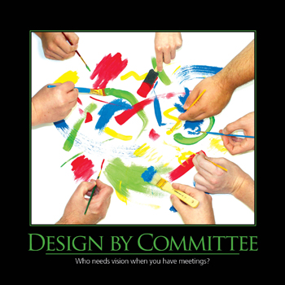
Design By Committee

Slide 64
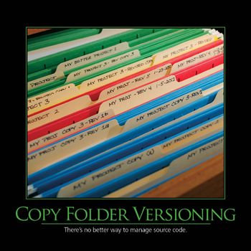
Copy Folder Versioning

Slide 65
SOLID And Other Principles
http://academy.telerik.com

Slide 66
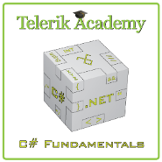



Free Trainings @ Telerik Academy
C# Programming @ Telerik Academy
csharpfundamentals.telerik.com
Telerik Software Academy
academy.telerik.com
Telerik Academy @ Facebook
facebook.com/TelerikAcademy
Telerik Software Academy Forums
forums.academy.telerik.com

